Slide 1
OA3103: Data Analysis
Statistical concepts review and Bias-Variance Decomposition

Slide 2
References
ISLP: Chapter 2
Shalizi: Chapters 1-2 (lite)
Central Limit Theorem (CLT) Review video:
3blue1brown: “But what is the Central Limit Theorem?”
https://www.youtube.com/watch?v=zeJD6dqJ5lo&t=1312s

Slide 3
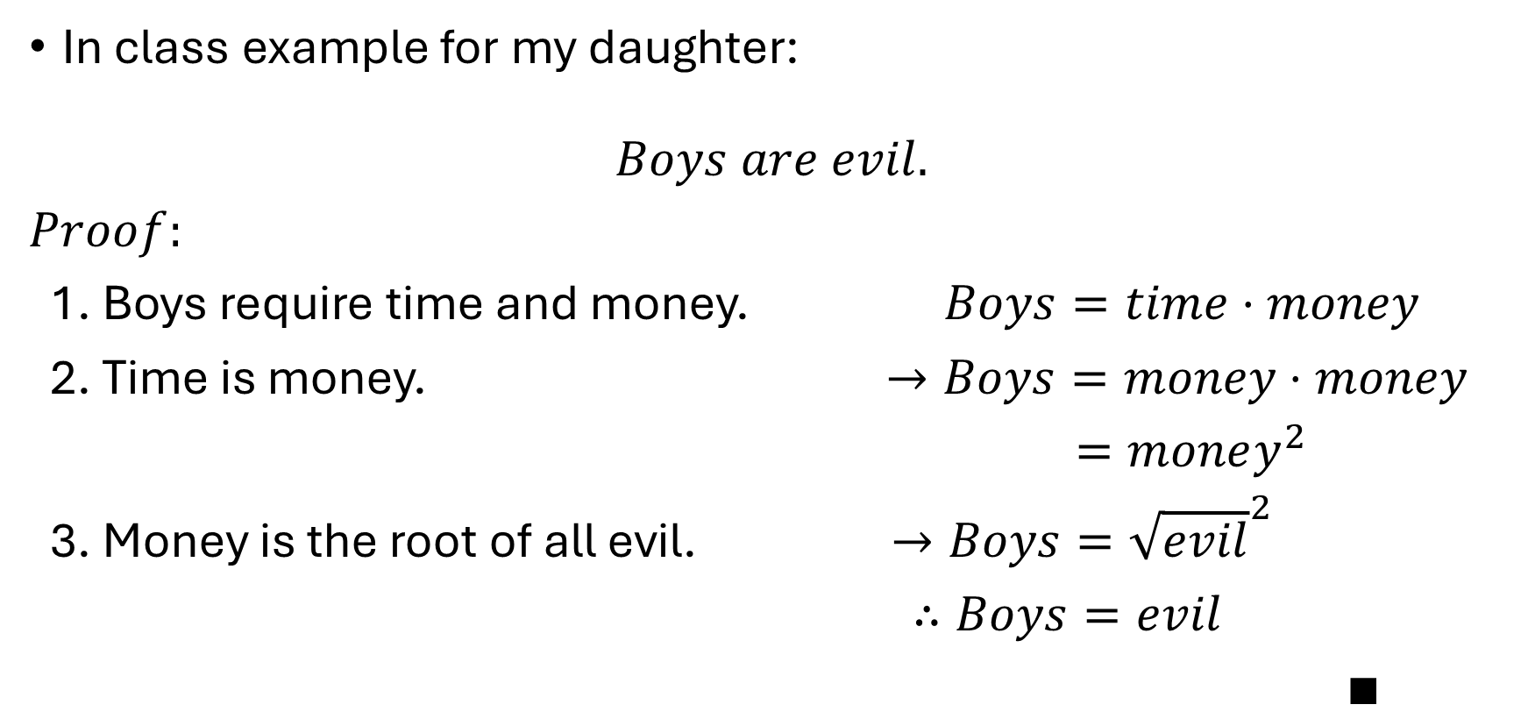
Using Math to Prove or Explain Real Phenomena
In class example for my daughter:
$$Boys are evil.$$
$Proof:$
1. Boys require time and money. $Boys=time⋅money$
2. Time is money. $→Boys=money⋅money$
$=money^{2}$
3. Money is the root of all evil. $→Boys={\sqrt{evil}}^{2}$
$∴Boys=evil$
$∎$

Slide 4
Using Math to Prove or Explain Real Phenomena
Today we will quantify the phrase:
“All models are wrong.”
First, we will review the statistical concepts from yesterday.

Slide 5
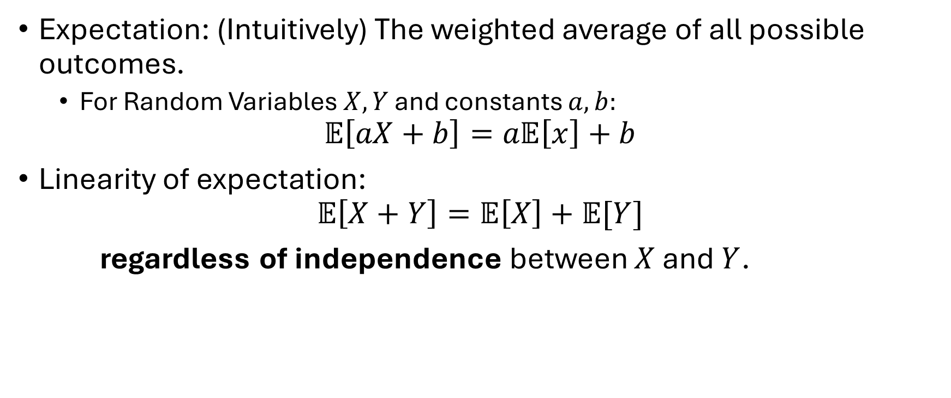
Review of Statistical Concepts
Expectation: (Intuitively) The weighted average of all possible outcomes.
For Random Variables $X,Y$ and constants $a,b:$
$$𝔼\left[aX+b\right]=a𝔼\left[x\right]+b$$
Linearity of expectation:
$$𝔼\left[X+Y\right]=𝔼\left[X\right]+𝔼[Y]$$
regardless of independence between $X$ and $Y$.

Slide 6
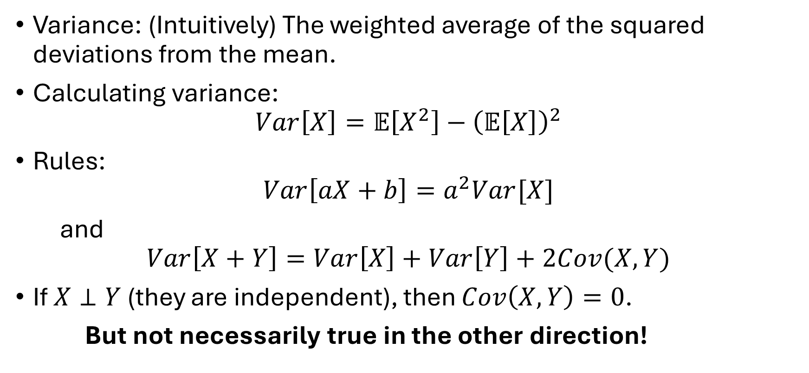
Review of Statistical Concepts
Variance: (Intuitively) The weighted average of the squared deviations from the mean.
Calculating variance:
$$Var\left[X\right]=𝔼\left[X^{2}\right]−{\left(𝔼\left[X\right]\right)}^{2}$$
Rules:
$$Var\left[aX+b\right]=a^{2}Var[X]$$
and
$$Var\left[X+Y\right]=Var\left[X\right]+Var\left[Y\right]+2Cov(X,Y)$$
If $X⊥Y$ (they are independent), then $Cov\left(X,Y\right)=0$.
But not necessarily true in the other direction!

Slide 7
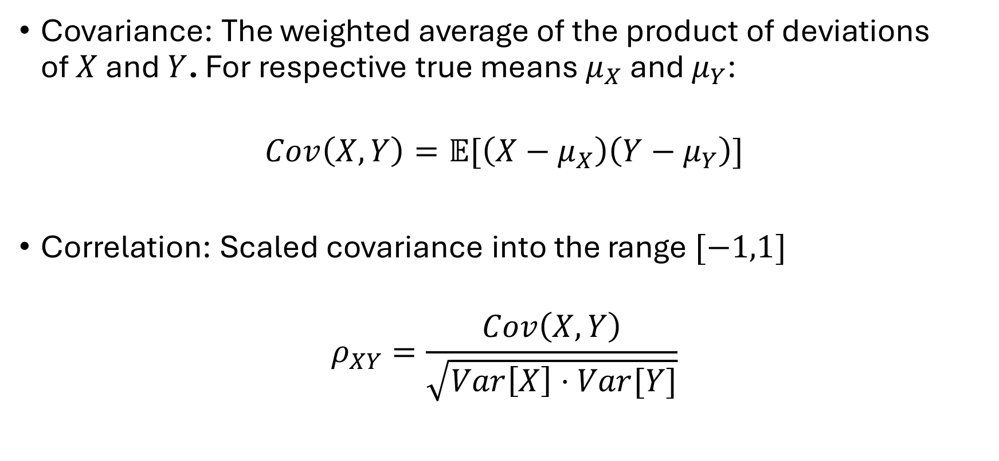
Review of Statistical Concepts
Covariance: The weighted average of the product of deviations of $X$ and $Y$. For respective true means $μ_{X}$ and $μ_{Y}$:
$$Cov\left(X,Y\right)=𝔼[\left(X−μ_{X}\right)\left(Y−μ_{Y}\right)]$$
Correlation: Scaled covariance into the range $[−1,1]$
$$ρ_{XY}=\frac{Cov\left(X,Y\right)}{\sqrt{Var\left[X\right]⋅Var[Y]}}$$

Slide 8
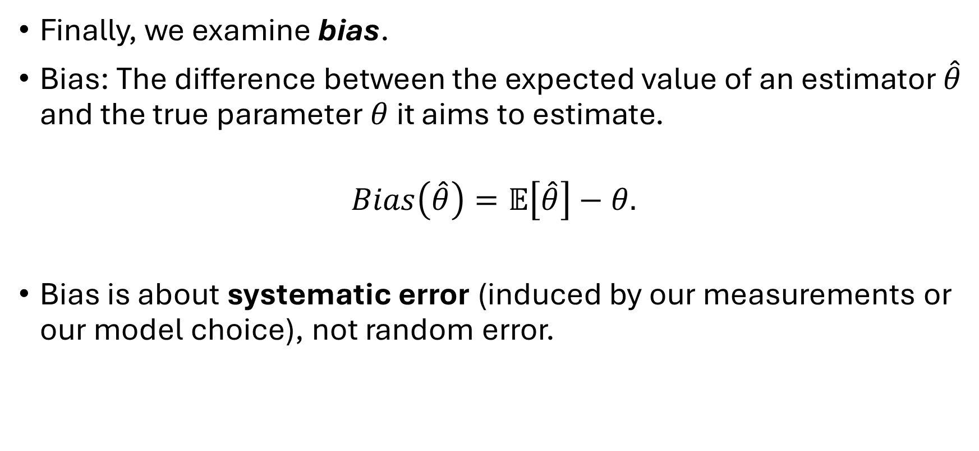
Review of Statistical Concepts
Finally, we examine bias.
Bias: The difference between the expected value of an estimator $\hat{θ}$ and the true parameter $θ$ it aims to estimate.
$$Bias\left(\hat{θ}\right)=𝔼\left[\hat{θ}\right]−θ.$$
Bias is about systematic error (induced by our measurements or our model choice), not random error.

Slide 9
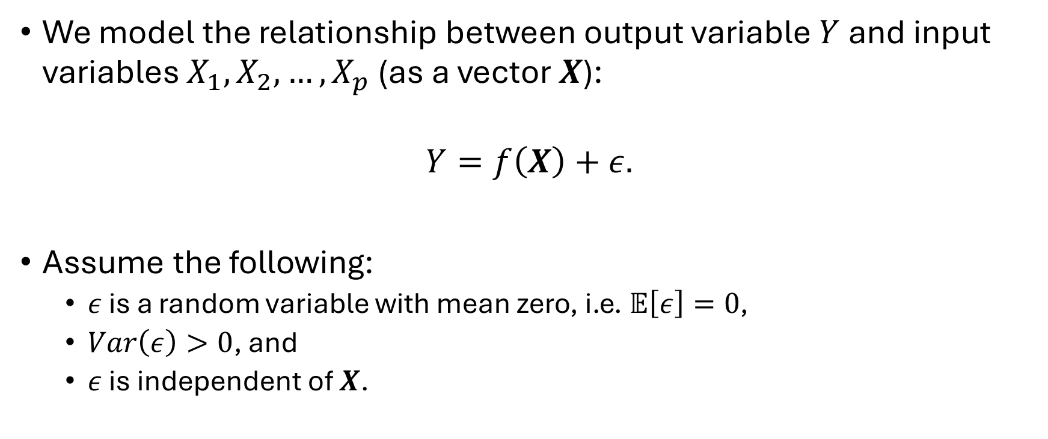
Statistical Modeling
We model the relationship between output variable $Y$ and input variables $X_{1},X_{2},…,X_{p}$ (as a vector $X$):
$$Y=f\left(X\right)+ε.$$
Assume the following:
$ε$ is a random variable with mean zero, i.e. $𝔼\left[ε\right]=0$,
$Var\left(ε\right)>0$, and
$ε$ is independent of $X$.

Slide 10
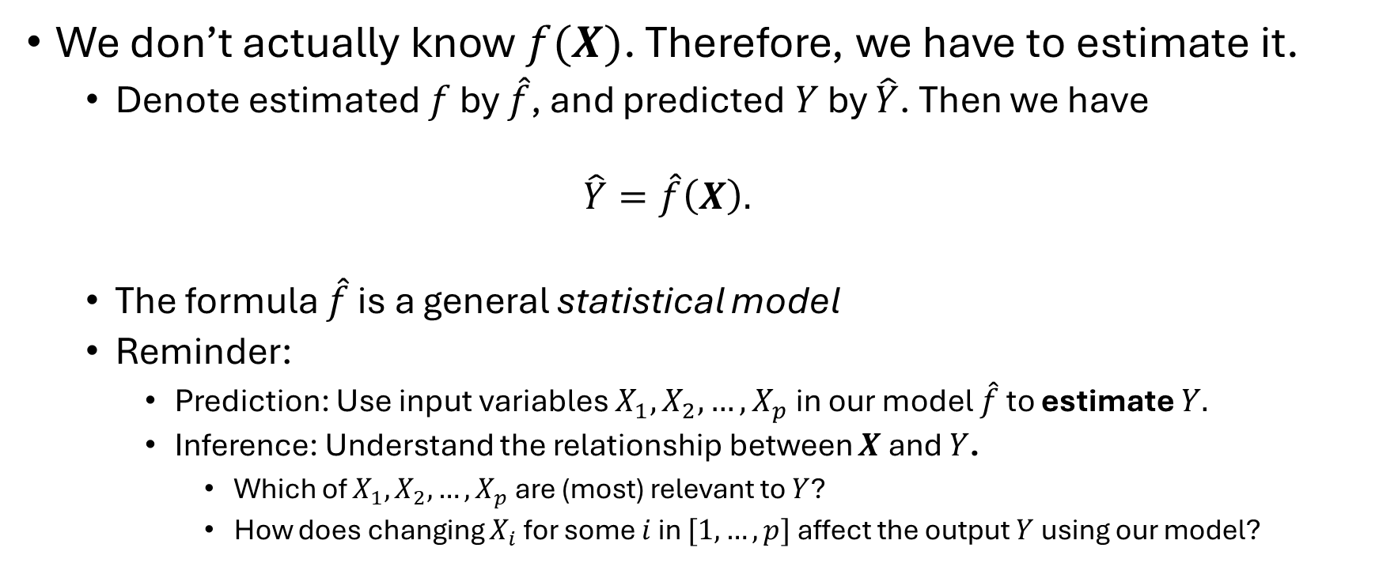
Statistical Modeling
We don’t actually know $f(X)$. Therefore, we have to estimate it.
Denote estimated $f$ by $\hat{f}$, and predicted $Y$ by $\hat{Y}$. Then we have
$$\hat{Y}=\hat{f}\left(X\right).$$
The formula $\hat{f}$ is a general statistical model
Reminder:
Prediction: Use input variables $X_{1},X_{2},…, X_{p}$ in our model $\hat{f}$ to estimate $Y.$
Inference: Understand the relationship between $X$ and $Y$.
Which of $X_{1},X_{2},…,X_{p}$ are (most) relevant to $Y$?
How does changing $X_{i}$ for some $i$ in $[1,…,p]$ affect the output $Y$ using our model?

Slide 11
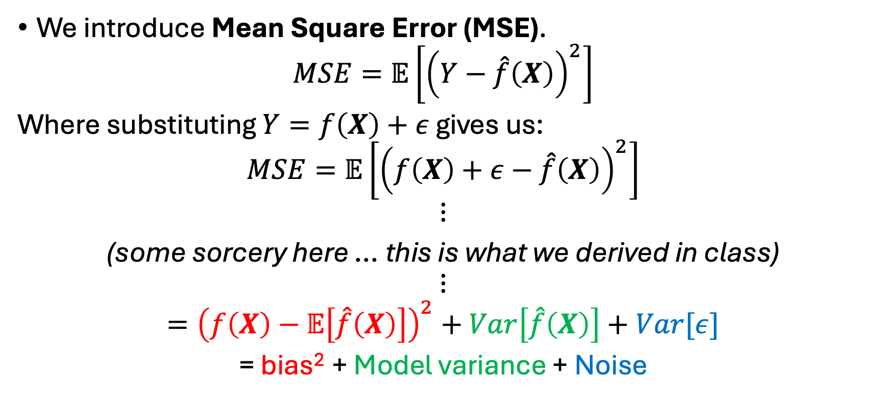
Prediction: What is the best we can do?
We introduce Mean Square Error (MSE).
$$MSE=𝔼\left[{\left(Y−\hat{f}\left(X\right)\right)}^{2}\right]$$
Where substituting $Y=f\left(X\right)+ε$ gives us:
$$MSE=𝔼\left[{\left(f\left(X\right)+ε−\hat{f}\left(X\right)\right)}^{2}\right]$$
$$⋮$$
(some sorcery here … this is what we derived in class)
$$⋮$$
$$={\left(f\left(X\right)−𝔼\left[\hat{f}\left(X\right)\right]\right)}^{2}+Var\left[\hat{f}\left(X\right)\right]+Var[ε]$$
= bias² + Model variance + Noise

Slide 12
Bias-Variance Decomposition
This is called a bias-variance decomposition.
MSE = bias² + Model variance + Noise
We cannot control the randomness in the irreducible error. We can, however, control the reducible error by selecting a model and training the parameters with training data. Thus the best we can do is to approach the irreducible error as close as possible from above.
Reducible error
Irreducible error

Slide 13
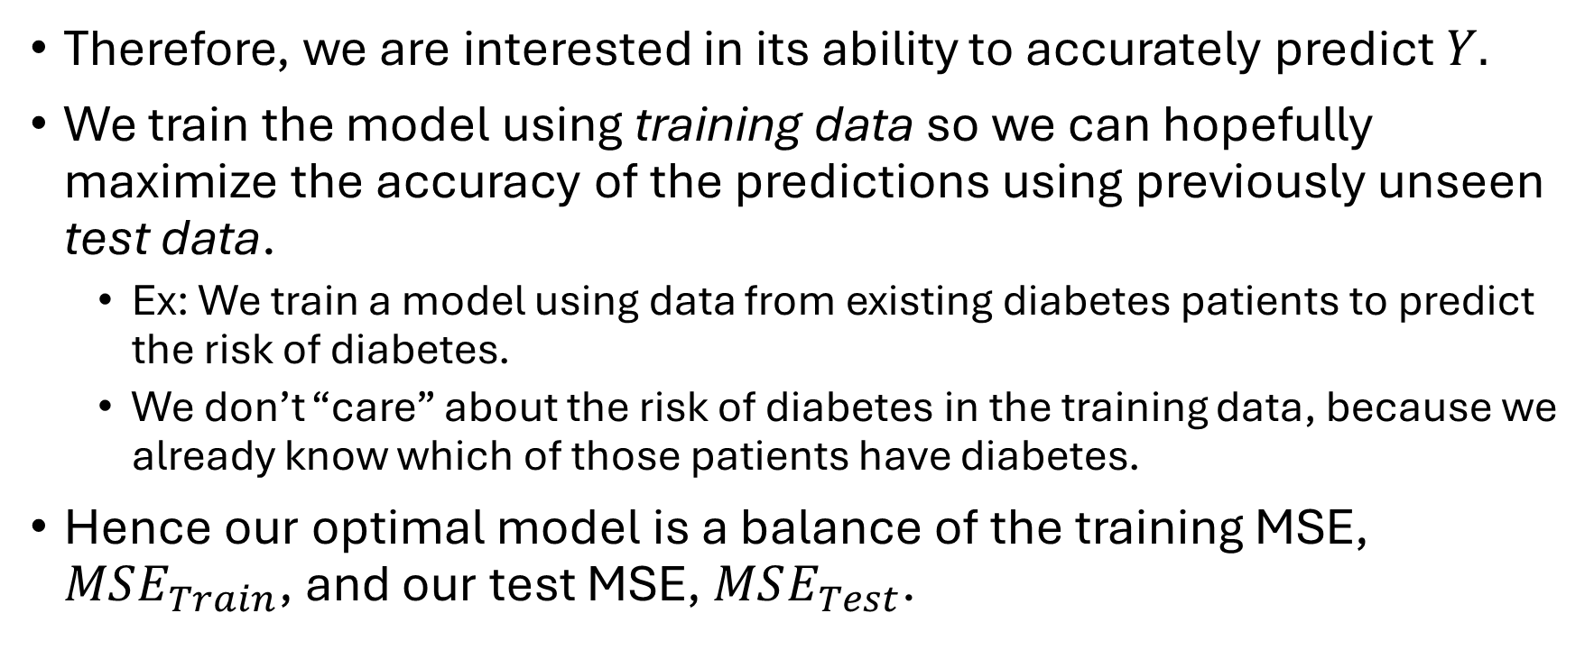
But we are doing prediction with our model
Therefore, we are interested in its ability to accurately predict $Y.$
We train the model using training data so we can hopefully maximize the accuracy of the predictions using previously unseen test data.
Ex: We train a model using data from existing diabetes patients to predict the risk of diabetes.
We don’t “care” about the risk of diabetes in the training data, because we already know which of those patients have diabetes.
Hence our optimal model is a balance of the training MSE, $MSE_{Train}$, and our test MSE, $MSE_{Test}$.

Slide 14
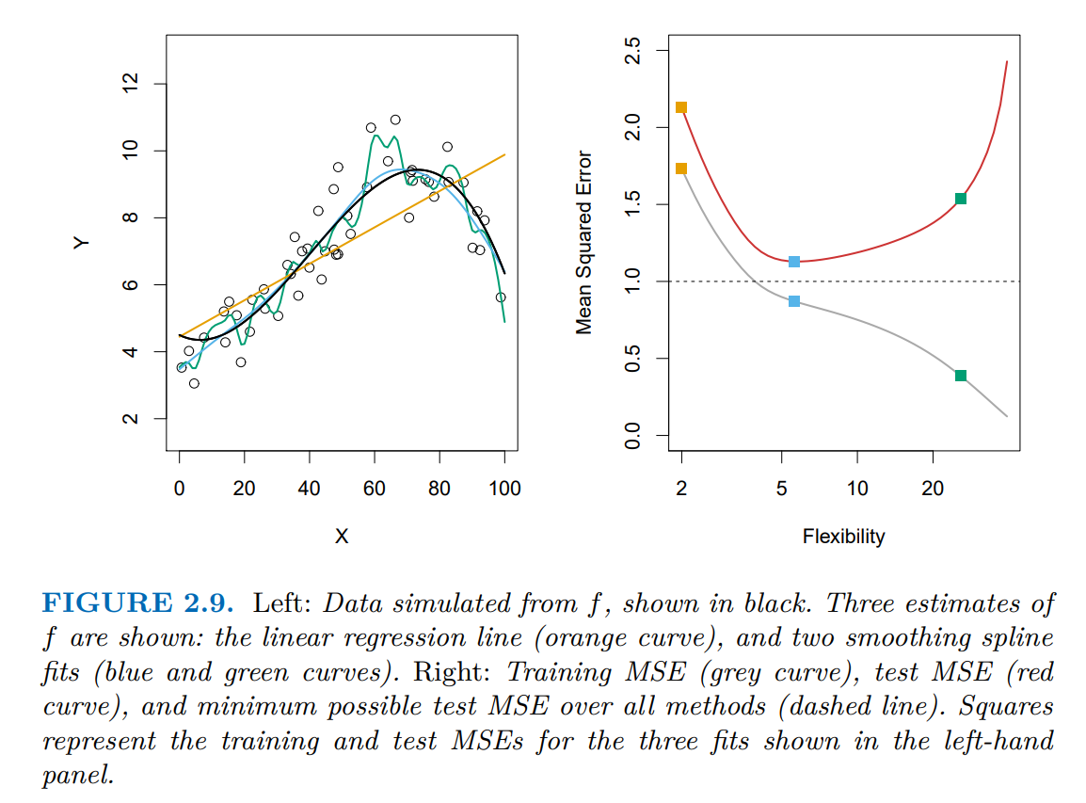

Training vs Test RMSE
Hence our optimal model is a balance of the training MSE, $MSE_{Train}$, and our test MSE, $MSE_{Test}$.
Image sourced from Figure 2.9 of ISLP.

Slide 15
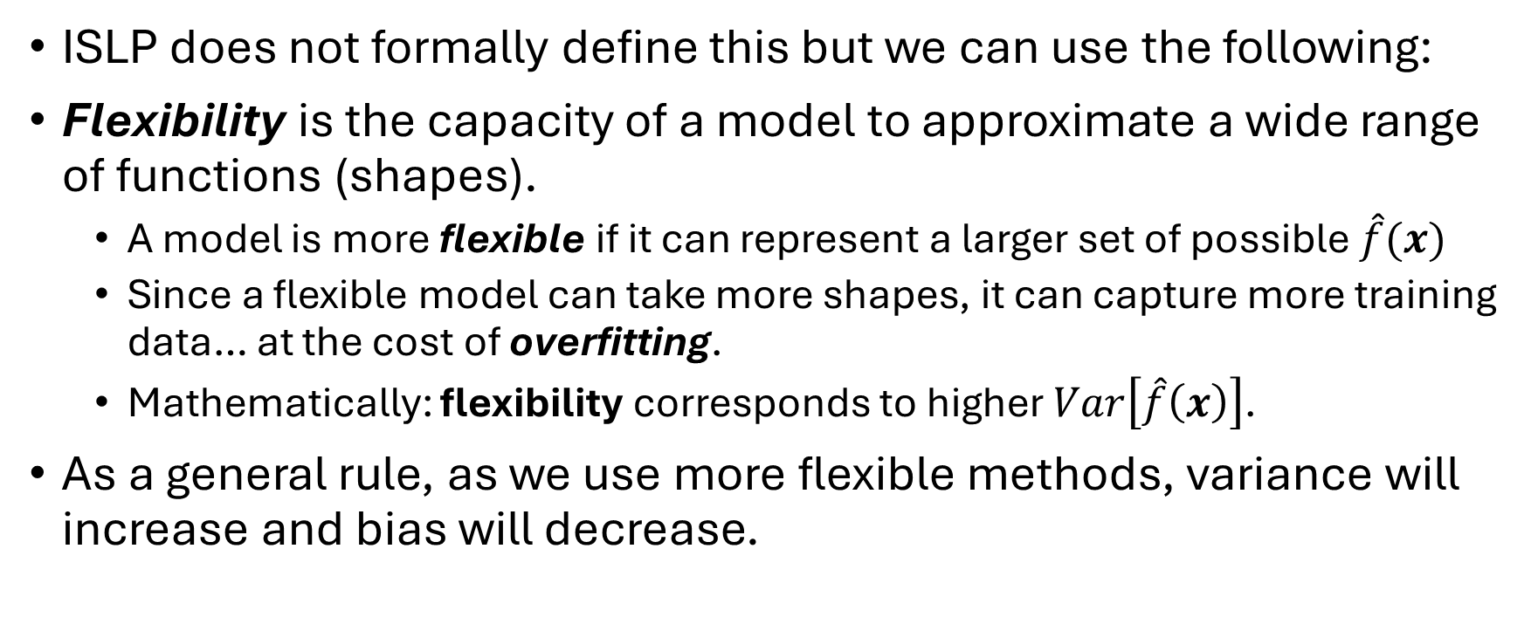
Flexibility
ISLP does not formally define this but we can use the following:
Flexibility is the capacity of a model to approximate a wide range of functions (shapes).
A model is more flexible if it can represent a larger set of possible $\hat{f}(x)$
Since a flexible model can take more shapes, it can capture more training data… at the cost of overfitting.
Mathematically: flexibility corresponds to higher $Var\left[\hat{f}\left(x\right)\right]$.
As a general rule, as we use more flexible methods, variance will increase and bias will decrease.

Slide 16

Training vs Test RMSE
Hence our optimal model is a balance of the training MSE, $MSE_{Train}$, and our test MSE, $MSE_{Test}$.
The left plot depicts various fits via a smoothing spline process.
Right plot: Flexibility (x-axis) is quantified by the degrees of freedom of the respective smoothing spline model.
Image sourced from Figure 2.9 of ISLP.

Slide 17
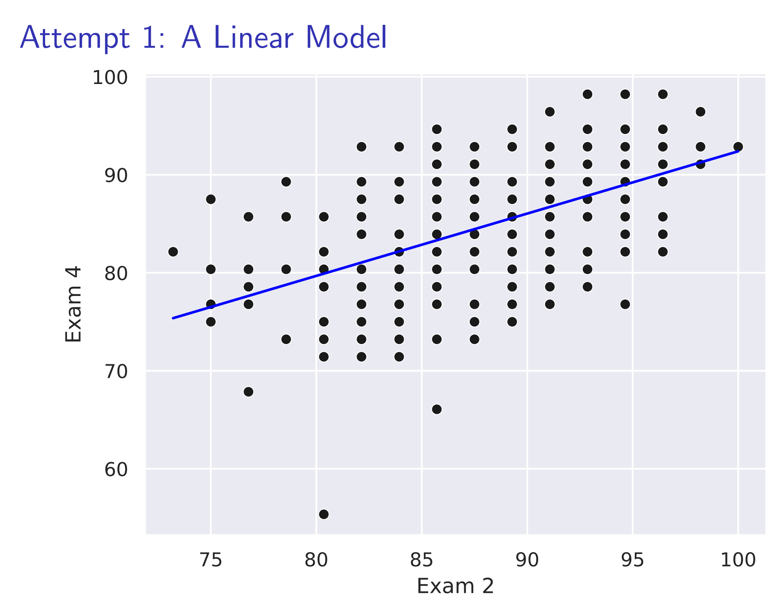

Slide 18
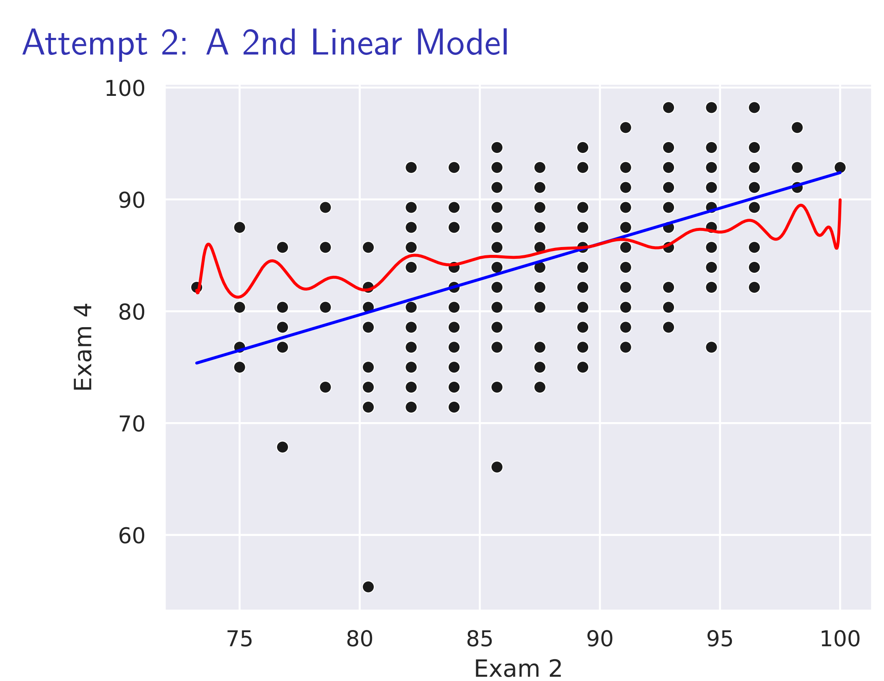

Slide 19
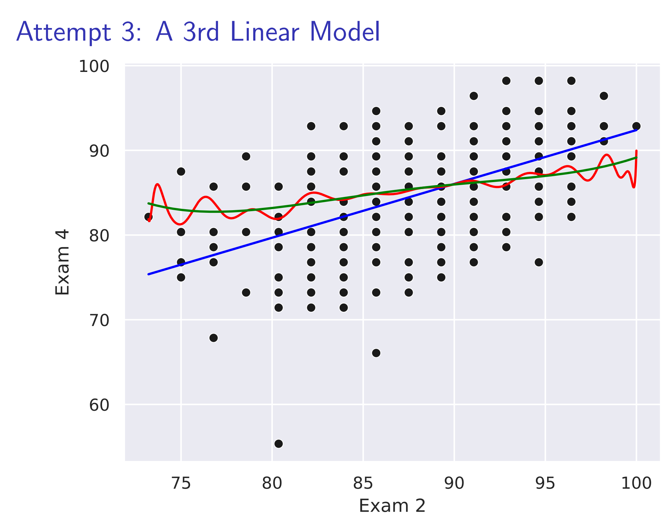

Slide 20
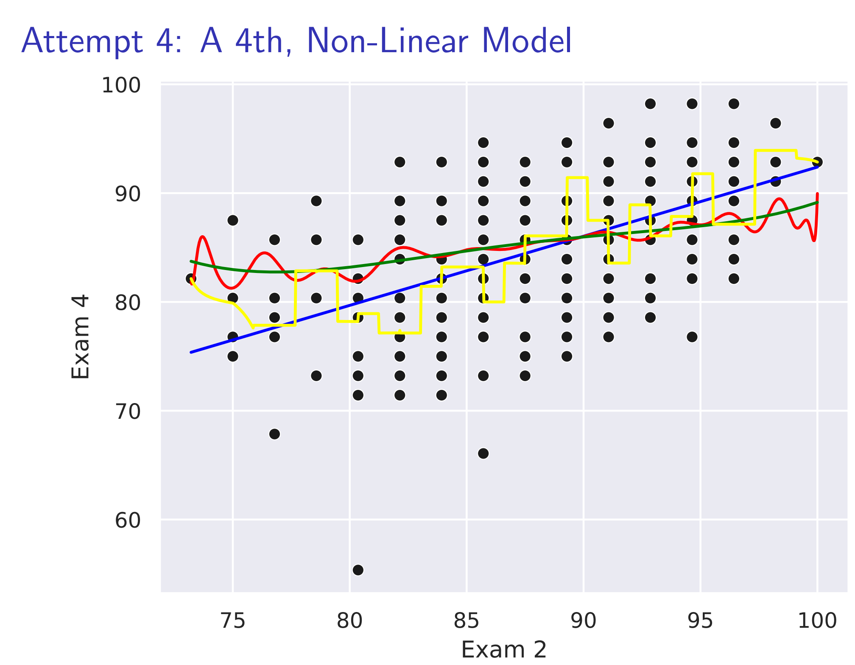

Slide 21

Overfitting
Hence our optimal model is a balance of the training MSE, $MSE_{Train}$, and our test MSE, $MSE_{Test}$.
Overfitting occurs when our model too closely follows the error or noise.
This is undesirable!
The fit will not yield accurate predictions on new observations (test data) that the model hasn’t yet seen.
Image sourced from Figure 2.9 of ISLP.

Slide 22
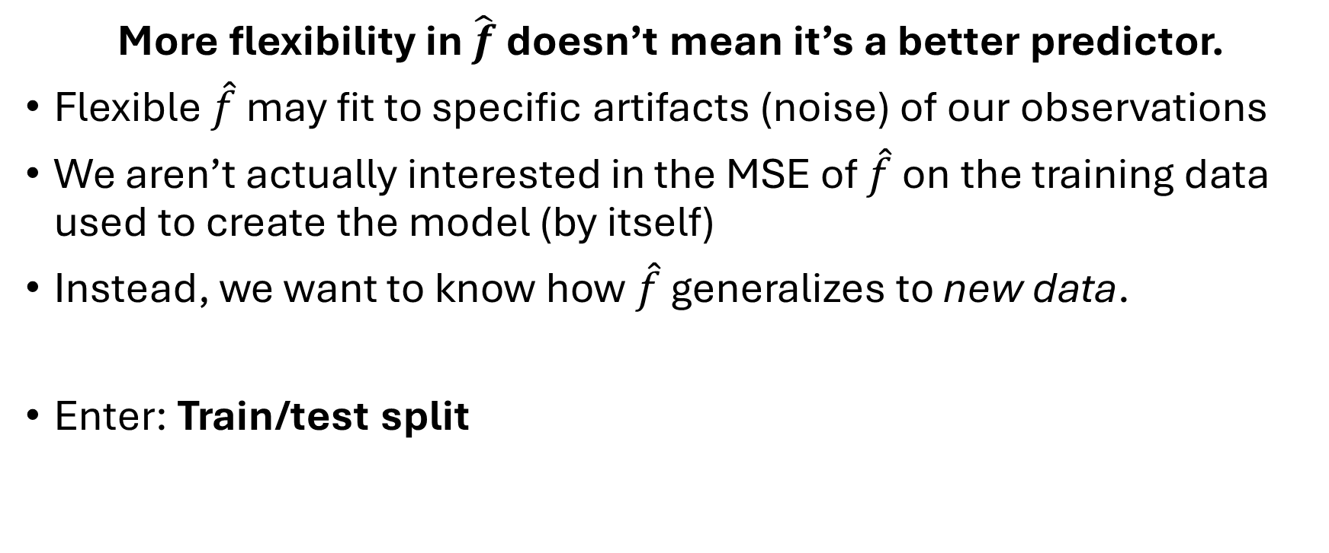
Takeaways
More flexibility in $\hat{f}$ doesn’t mean it’s a better predictor.
Flexible $\hat{f}$ may fit to specific artifacts (noise) of our observations
We aren’t actually interested in the MSE of $\hat{f}$ on the training data used to create the model (by itself)
Instead, we want to know how $\hat{f}$ generalizes to new data.
Enter: Train/test split

Slide 23
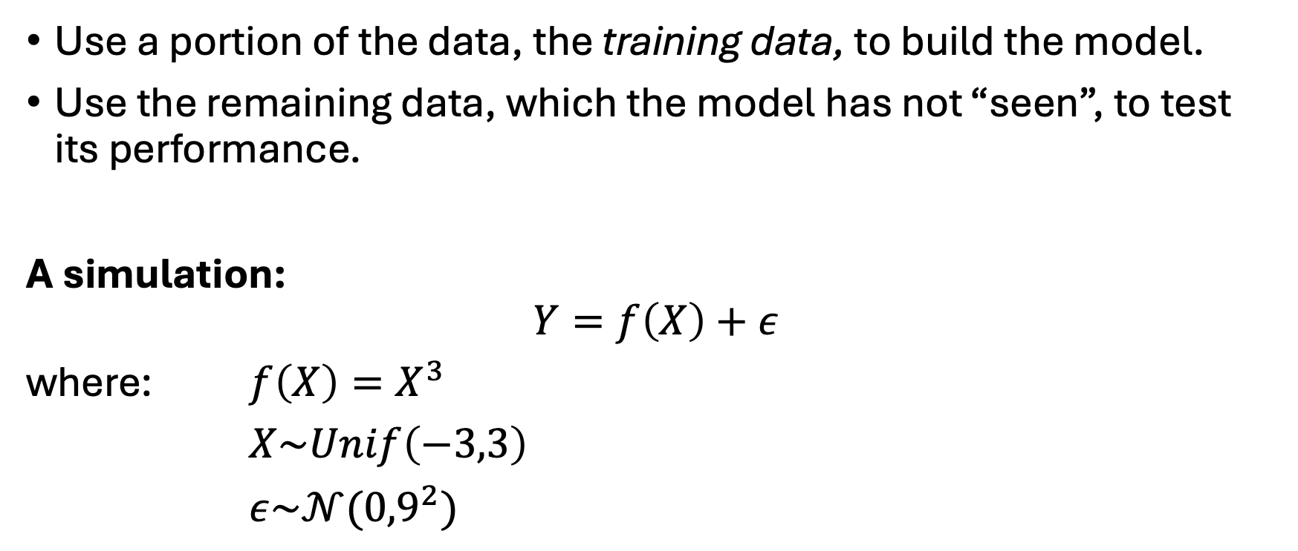
Train/test split
Use a portion of the data, the training data, to build the model.
Use the remaining data, which the model has not “seen”, to test its performance.
A simulation:
$$Y=f\left(X\right)+ε$$
where: $f\left(X\right)=X^{3}$
$X\sim Unif\left(−3,3\right)$
$ε\sim 𝒩({0,9}^{2})$

Slide 24
The Truth and Sample

Slide 25
The Train/Test Split and Truth

Slide 26
A linear estimate
●
●
● ●
● ●
●
●●
25
●
●
●
● ● ●●
●
● ●● ● ●
●
●
● ●
● ● ●
●
●
●
●
●
●
●●
●
● ●● ●
●
●
● ●●
●
● ●
● ●
● ●
● ●
●
●
●
●
●
● ● ● ● ●● ●
Data Group
●● ● ● ● ● ● ●● ●
●
● ●
●
● ● ●● ●●
●
●
●
● ● ● ●
● ●
●
●
●
● ● ●● ●●●
●
●
● ●
● ●
● ●
● ●● ● ● ●● ● ● ●
●
y
0
●
● ●
●
●● ● ●
●
●
●
●
Test
Train
●
●
● ●
● ● ● ●
● ● ● ● ●
● ●
● ● ● ●● ●●
● ●
●
●● ● ● ● ●● ● ● ● ●
● ●
●
● ● ● ● ● ●
● ● ●
● ●
● ●
●
●
●
●
●● ● ● ● ●
● ●
●●
● ● ●
●●
●
●
● ●
● ● ●
● ●
● ●
● ●
● ● ●
●
●
●
●
● ●
● ●
●●
●
●
−25
●
●
●
●
●●● ● ●
●
● ●
●
●
−2
0
x
2

Slide 27
Another estimate
●
●
● ●
● ●
●
●●
25
●
●
●
● ● ●●
●
● ●● ● ●
●
●
● ●
● ● ●
●
●
●
●
●
●
●●
●
● ●● ●
●
●
● ●●
●
● ●
● ●
● ●
● ●
●
●
●
●
●
● ● ● ● ●● ●
Data Group
●● ● ● ● ● ● ●● ●
●
● ●
●
● ● ●● ●●
●
●
●
● ● ● ●
● ●
●
●
●
● ● ●● ●●●
●
●
● ●
● ●
● ●
● ●● ● ● ●● ● ● ●
●
y
0
●
● ●
●
●● ● ●
●
●
●
●
Test
Train
●
●
● ●
● ● ● ●
● ● ● ● ●
● ●
● ● ● ●● ●●
● ●
●
●● ● ● ● ●● ● ● ● ●
● ●
●
● ● ● ● ● ●
● ● ●
● ●
● ●
●
●
●
●
●● ● ● ● ●
● ●
●●
● ● ●
●●
●
●
● ●
● ● ●
● ●
● ●
● ●
● ● ●
●
●
●
●
● ●
● ●
●●
●
●
−25
●
●
●
●
●●● ● ●
●
● ●
●
●
−2
0
x
2

Slide 28
Another estimate
40
●
●
● ●
● ●
●
●●
●
●
●
● ● ●●
●
● ●● ● ●
20
●
●
● ●
● ● ●
●
●
●
●
●
●
●
●●
●
● ●● ●
●
●
● ●●
●
●
● ●
●
● ●
●
●
●
●
● ●● ●
●
●
● ● ●
●
● ●
●● ● ● ● ● ●
●
●
● ● ●
● ● ● ● ● ●
● ●●
●
● ●
●
●●
● ●
●
●
●
●
Data Group
0
●
● ● ●● ● ●
● ●● ●
●
● ●
● ●
●
●
● ●● ●●
●
●
●
● ● ● ● ●
● ● ● ● ●
●
●
● ●● ●
● ●
●● ● ● ● ● ● ●● ● ● ●●
Test
Train
y
● ● ● ●
● ● ●
● ● ●
●
●
●
● ●
●●
● ●
● ●
● ●
● ● ● ●
●
●
●
●● ● ● ● ●
●●
● ●
●
●
●
● ● ●
●
●
●
● ●
●
●
● ● ●
●
●
● ● ●
●
−20
● ●
●● ●
●
●
●
●
● ●●
●
● ●
●
● ●
●
−40
●
−2
0
x
2

Slide 29
Train and test error
●
●
 | ● |  | ● |  | ●
 | ● |  | ● |  | ●
110
100
Error Type
MSE
●
●
Test
Train
90
5
10
Number of Parameters

Slide 30
Train and test error
●
●
●
●
●
●
●
●
110
100
Error Type
MSE
●
●
Test
Train
90
80
The Truth!
5
10
Number of Parameters

Slide 31
Train and test error
The training MSE measures the model’s performance on its training data.
The test MSE measures the model’s ability to generalize to unseen data.
Overtraining: When the model’s overabundance of flexibility increases test MSE over simpler models.
Note: The square-root of the MSE is sometimes used as a measure of performance. This can be denoted RMSE.

Slide 32
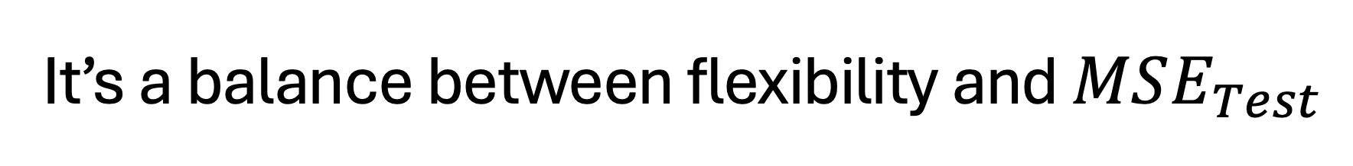
It’s a balance between flexibility and $MSE_{Test}$

Slide 33
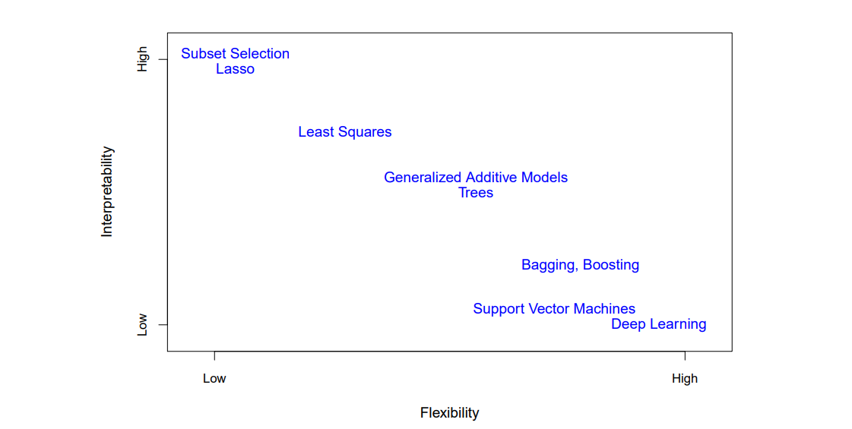
Some of the models we will encounter
Image sourced from Figure 2.7 of ISLP.

Slide 34
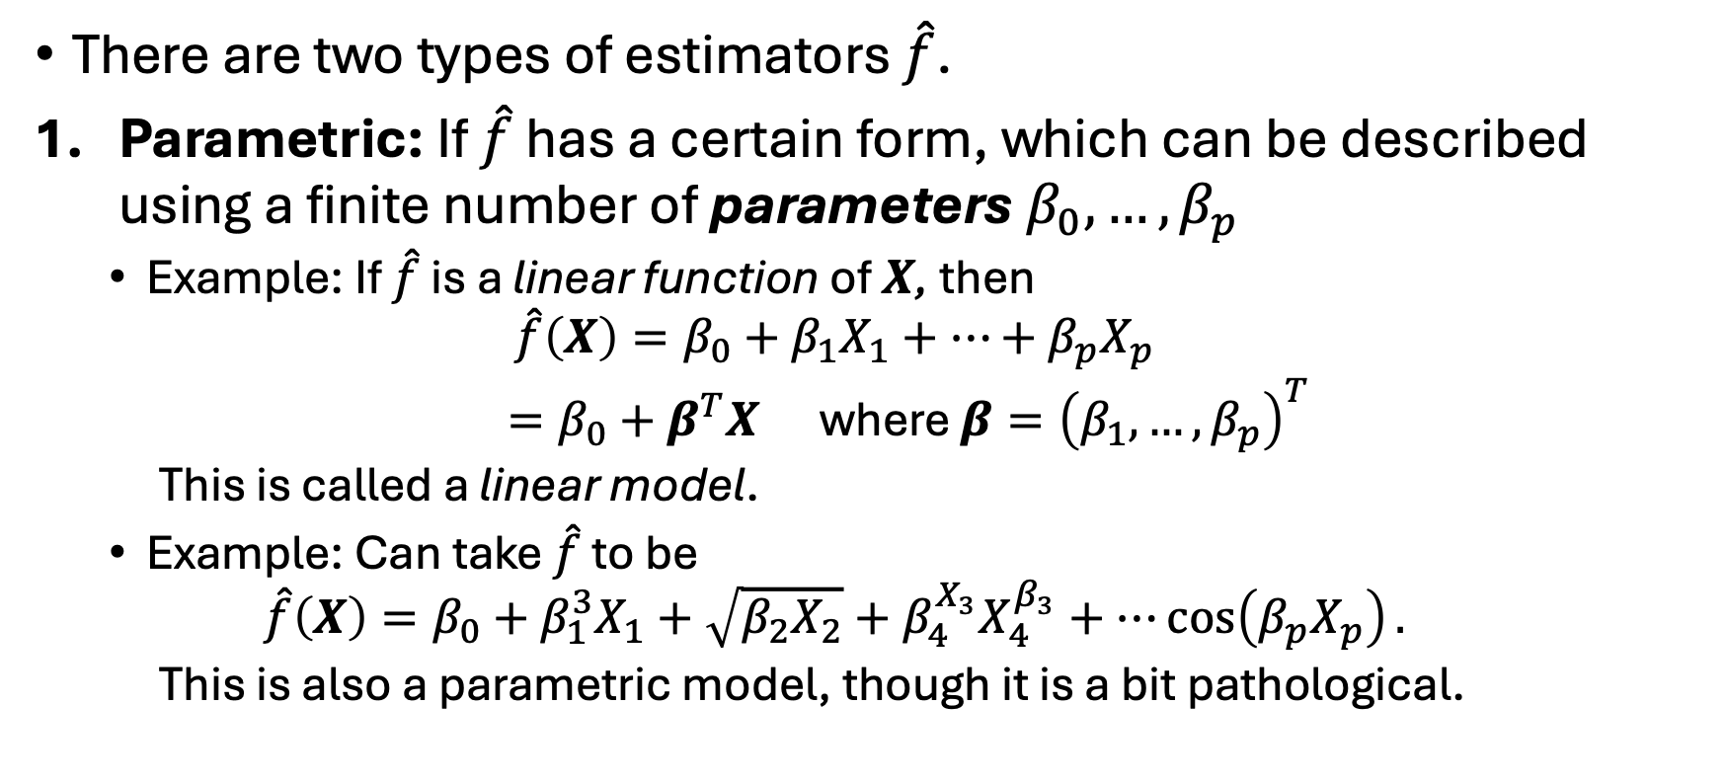
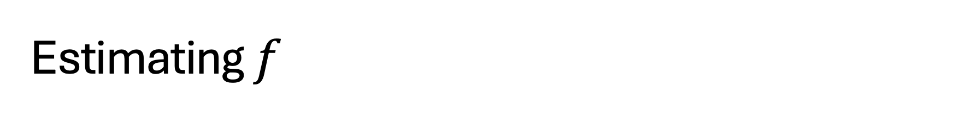
Estimating $f$
There are two types of estimators $\hat{f}$.
Parametric: If $\hat{f}$ has a certain form, which can be described using a finite number of parameters $β_{0}, …,β_{p}$
Example: If $\hat{f}$ is a linear function of $X$, then
$$\hat{f}\left(X\right)=β_{0}+β_{1}X_{1}+…+β_{p}X_{p}$$
$=β_{0}+β^{T}X$ where $β={\left(β_{1},…,β_{p}\right)}^{T}$
This is called a linear model.
Example: Can take $\hat{f}$ to be
$$\hat{f}\left(X\right)=β_{0}+β_{1}^{3}X_{1}+\sqrt{β_{2}X_{2}}+β_{4}^{X_{3}}X_{4}^{β_{3}}+…\cos\left(β_{p}X_{p}\right).$$
This is also a parametric model, though it is a bit pathological.

Slide 35
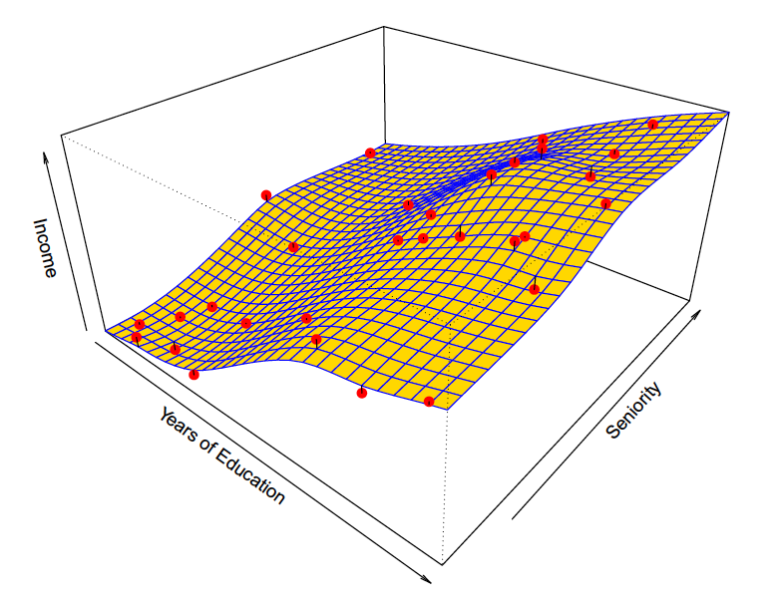

Estimating $f$
Non-parametric: If we do not impose a parametric structure on $\hat{f}$. Non-parametric methods can be deceptively simple or very complex.
We will use them, but not delve into their details.
They do not assume the form of $f$, but suffer from needing a very large number of observations.
Image sourced from Figure 2.5 of ISLP.

Slide 36
The Hard Truth
For prediction, linear models are largely obsolete.
They are still useful as a point of comparison for modern methods, but they are seldom the best option.
The modeling skills you develop working with linear models will extend to other methods.
For inference, linear models are still very relevant.
Their well-developed theory, which many modern methods lack, provide a foundation for difficult inference tasks.

Slide 37
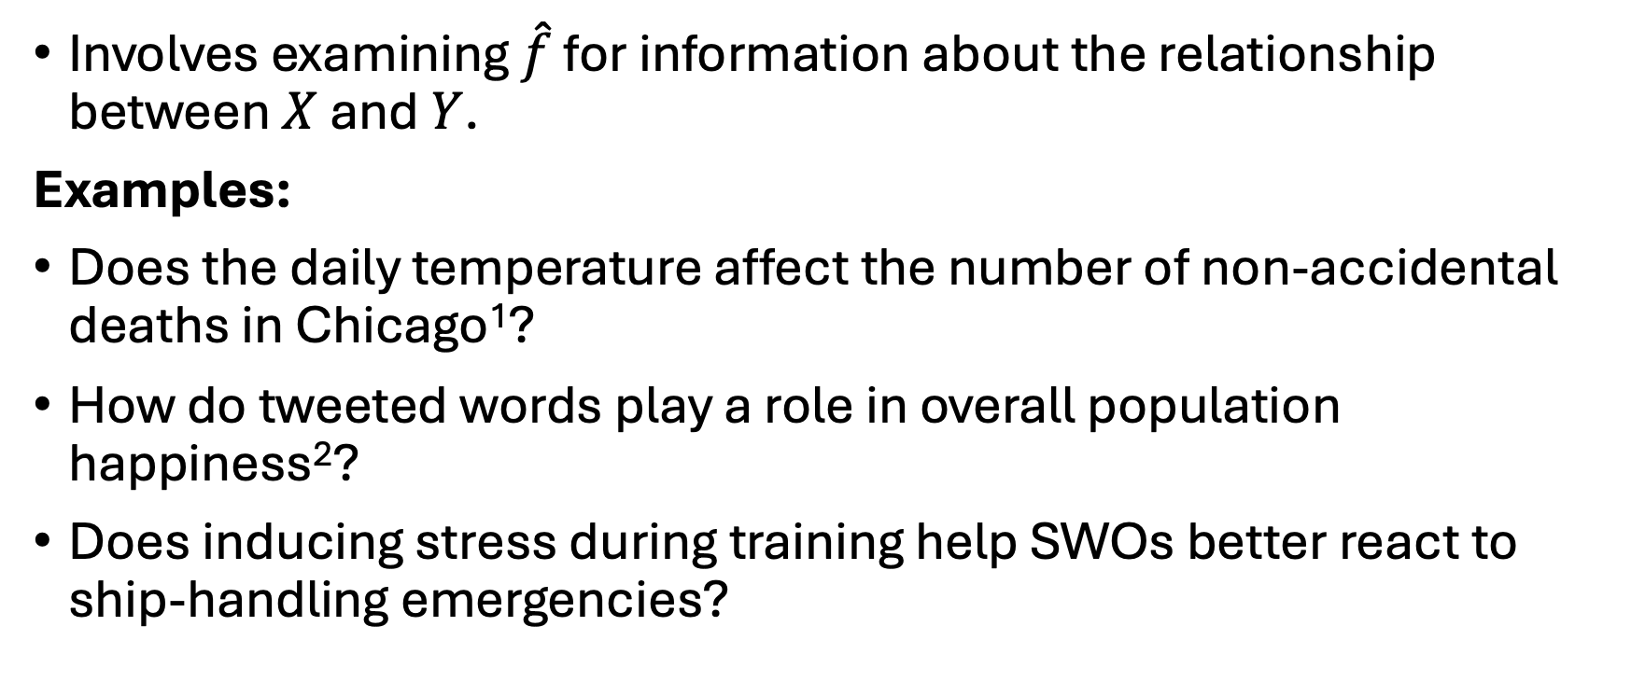
Inference
Involves examining $\hat{f}$ for information about the relationship between $X$ and $Y$.
Examples:
Does the daily temperature affect the number of non-accidental deaths in Chicago¹?
How do tweeted words play a role in overall population happiness²?
Does inducing stress during training help SWOs better react to ship-handling emergencies?

Slide 38
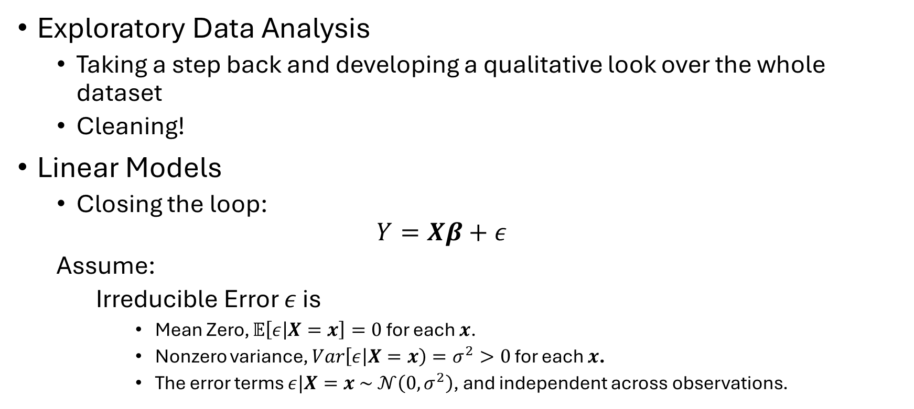
Coming up
Exploratory Data Analysis
Taking a step back and developing a qualitative look over the whole dataset
Cleaning!
Linear Models
Closing the loop:
$$Y=Xβ+ε$$
Assume:
Irreducible Error $ε$ is
Mean Zero, $𝔼\left[ε | X=x\right]=0$ for each $x$.
Nonzero variance, $Var\left[ε | X=x\right)=σ^{2}>0$ for each $x$.
The error terms $ε|X=x \sim 𝒩\left(0,σ^{2}\right)$, and independent across observations.

Slide 39
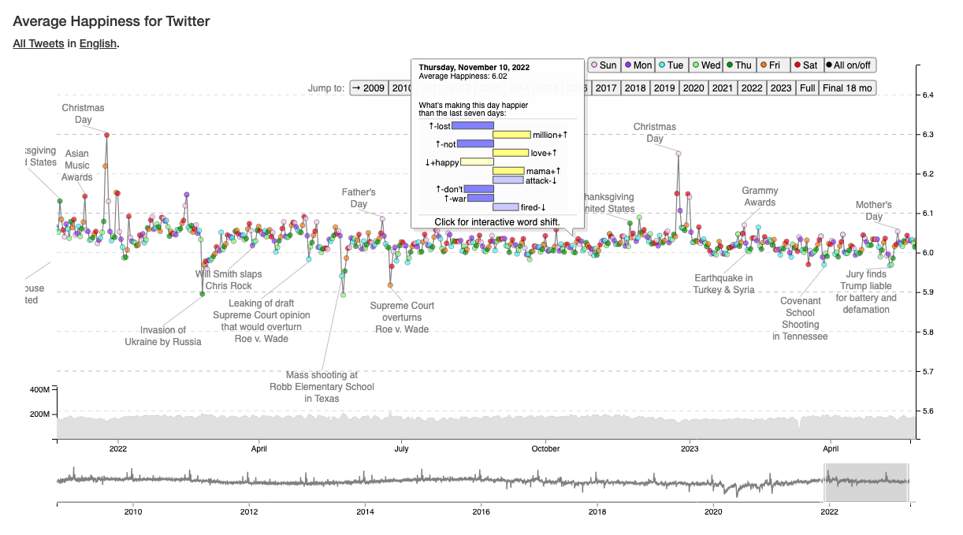
Questions?
¹ https://heyjackass.com/
² https://hedonometer.org/timeseries/en_all/?from=2021-11-23&to=2023-05-22&viz=wordshift

